Slide 1
Final Project Report
Course code: CSE 326
Section: 03
Project Name: Obstacle Avoidance Bot
Done by:
Raihan Munim
(181400138)
Submitted on:
Friday, September 17th , 2021

Slide 2
Project Summary
Obstacle avoiding robots can be used in almost all mobile robot navigation systems, they can be used as a automatic vacuum cleaner or can be used in dangerous environments where human intervention can be deadly. So I am designing the core model of it for general purpose, but this can be modified according to usage. It operates on dynamic steering algorithm that ensures the bot doesn’t stop in front of anything and navigate around it smoothly in an unknown environment, avoiding collisions.

Slide 3
Objective
The objective of this project was to create a bot that can avoid the objects that are in it’s path. Applications can be in automated bots that moves around the premises or to transport dangerous products without colliding with anything in it’s path. So first I had to get familiarized with the components, how to use them and to connect everything up in a circuit. The next stage was identifying all the components like the ultrasonic sensors and the motor drivers that the bot is based around. Next had to decide how to design the project that would maximize its use case and finally coding it to meet its specifications.

Slide 4
Components to be used:
Arduino Uno
3 Ultrasonic sensor (HC SR-04)
Potentiometer (POT-HG)
L293D motor drive
9V battery
4 DC Motors
4 Resistors
Virtual terminal
Jumper wires

Slide 5
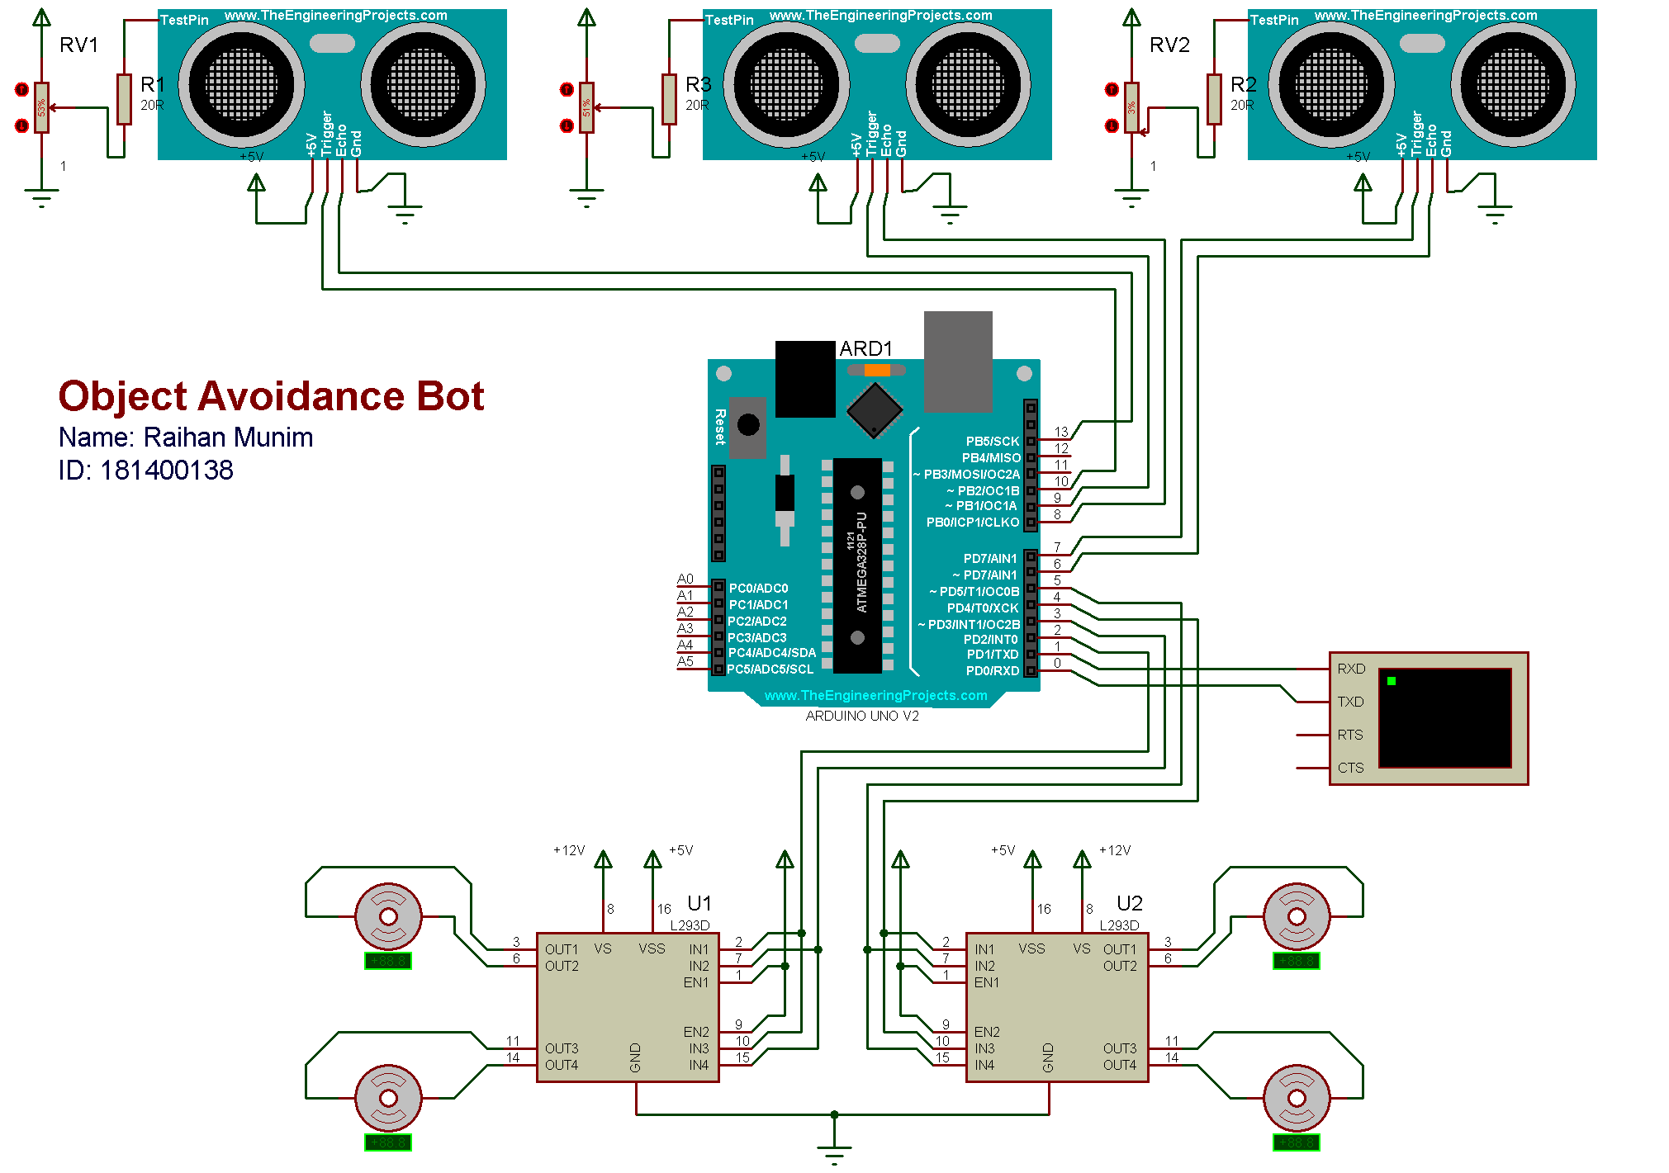
Circuit

